Slide 1
Anaphylaxis

Slide 2
Learning outcomes
This session should enable you to:
recognise anaphylaxis
identify common causes of anaphylaxis
treat anaphylaxis by following the anaphylaxis algorithm
describe refractory anaphylaxis
understand follow up and an ongoing care of patients with anaphylaxis

Slide 3
Recognising anaphylaxis
sudden onset and rapid progression of symptoms
Airway and/or Breathing and/or Circulation problems
skin and/or mucosal changes (flushing, urticaria, angioedema)
- but these may be absent in up to 20% of cases
the diagnosis is supported if the person has been exposed to an allergen known to affect them

Slide 4
Common causes of anaphylaxis
 | Anaphylaxis (all severities) | Fatal anaphylaxis
Foods | Commonest triggers: Peanuts Tree nuts Cow’s milk (children) | Commonest triggers: Peanut or tree nuts Cow’s milk
Medication | Commonest triggers are: Antibiotics Chemotherapy drugs Commonest triggers in peri-operative setting: Antibiotics Neuromuscular blocking agents (NMBAs) Chlorhexidine | Commonest triggers: NMBAs Antibiotics Contrast media Non-steroidal anti-inflammatory drugs
Insect stings | 6.5% of hospital admissions coded as anaphylaxis | 14% of anaphylaxis-related deaths

Slide 5
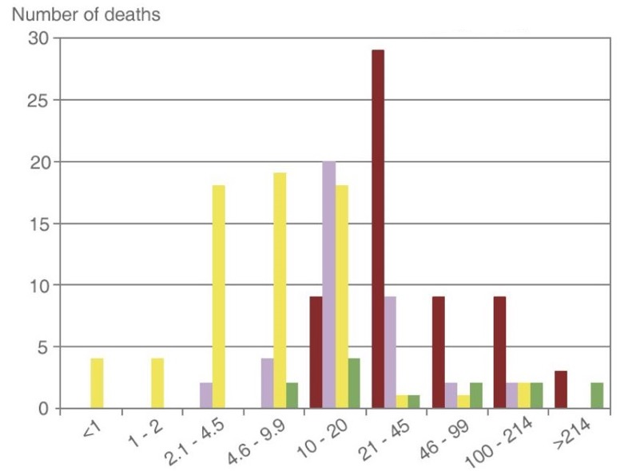
Time course for fatal anaphylaxis
Food
Stings
Drug - injected
Drug - oral
Time of first arrest (minutes)
Notes:
Time course for fatal anaphylaxis
Where anaphylaxis is fatal, death usually occurs very soon after exposure to the trigger. Fatal food reactions typically cause respiratory arrest after approximately 30 minutes; insect stings cause collapse from shock after 10–15 minutes; and deaths caused by IV medication occur most commonly within five minutes. Cardiorespiratory arrest more than 4 h after the initial allergen exposure is rare.

Slide 6
Spectrum of severity
Mild, localized skin symptoms and/or swelling of lips/face
Generalized skin reactions
Airway/Breathing/Circulation problems + skin symptoms
No Airway/Breathing/Circulation problems:
Not Anaphylaxis
A/B/C problems:
ANAPHYLAXIS
SEVERE
ANAPHYLAXIS

Slide 8
Assess using the ABCDE approach
Life-threatening problems
Airway
hoarse voice, stridor
Breathing
work of breathing,
wheeze, fatigue, cyanosis, SpO₂ <94%
Circulation
low blood pressure, signs of shock, confusion, reduced consciousness

Slide 9
Assess using the ABCDE approach
Disability
dizziness, decreased conscious level or loss of consciousness

Slide 10
Assess using the ABCDE approach
Exposure
flushed
itchy, urticaria or hives
angioedema

Slide 11
Removing trigger and positioning

Slide 12
Use adrenaline at 1 mg/mL (1:1000) concentration
Adult and child > 12 years: 500 micrograms IM (0.5 mL)
Child 6-12 years: 300 micrograms IM (0.3 mL)
Child 6 months to 6 years: 150 micrograms IM (0.15 mL)
Child <6 months: 100-150 micrograms IM (0.1-0.15 mL)
Inject at
anterolateral aspect –
middle third of the thigh
The above doses are for IM injection Only
Intravenous adrenaline for anaphylaxis to be given
only by experienced specialists in an appropriate setting

Slide 14
Oxygen and fluids
oxygen given as soon as available to achieve oxygen saturation of 94-98%
IV fluids (0.9% sodium chloride or balanced crystalloid)
10 mL kg⁻¹ for children
500-1000 mL in adults
larger volumes may be needed
consider IO route if no IV access

Slide 15
Antihistamines
not part of immediate emergency treatment
do not delay giving IM adrenaline and fluids
may be used to treat cutaneous symptoms
if giving, use a non-sedating oral antihistamine
(e.g. cetirizine)

Slide 16
Steroids
not part of immediate emergency treatment
give adrenaline and not steroids for anaphylaxis
only consider steroids for refractory anaphylaxis with ongoing asthma/shock

Slide 17
Bronchodilators
severe anaphylaxis and life-threatening asthma may present in a similar way
IM adrenaline is the first drug of choice
consider bronchodilators (e.g. salbutamol and ipratropium)
if there is evidence of bronchospasm
do not be give bronchodilators as an alternative to further treatment with adrenaline

Slide 18
Refractory Anaphylaxis
defined as:
anaphylaxis requiring ongoing treatment (due to persisting respiratory or cardiovascular symptoms) despite 2 appropriate doses of IM adrenaline
most patients only need one dose of adrenaline
very few patients need more than 2 doses of adrenaline

Slide 20
Investigations
should not delay treatment
as for a medical emergency:
12-lead ECG
Chest x-ray
urea and electrolytes
blood gases
mast cell tryptase

Slide 21
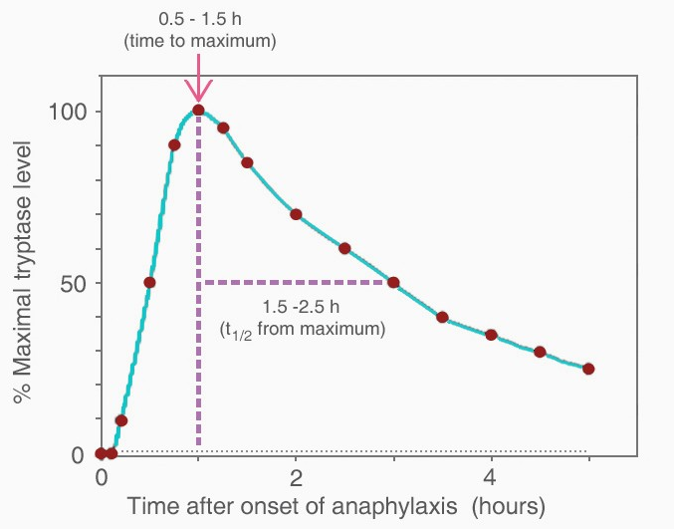
Mast cell tryptase
minimum: one sample (serum or plasma) within 2 h (when peak tryptase levels generally occur) and no later than
4 h after onset of symptoms
ideally: three timed samples:
1. as soon as feasible – do not delay treatment to take sample
2. 1–2 h (but no later than 4 h) after onset of symptoms
3. at least 24 h after complete resolution, or in convalescence
(Schwartz LB. Diagnostic value of tryptase in anaphylaxis and mastocytosis. Immunol Allergy Clin North Am 2006;26(3):451-63)

Slide 22
Discharge
and
follow-up
*It may be reasonable for some patients to be discharged after 2 hours despite needing
two doses of IM adrenaline, e.g. following a supervised allergy challenge in a specialist setting.

Slide 23
Discharge and follow-up
consider prescribing adrenaline auto-injector to all patients with anaphylaxis
may not be the case if drug-induced anaphylaxis and unlikely to encounter allergen again
specialist referral
refer all patients to an allergy clinic
patient education
prevention, recognition and emergency management/treatment
reporting
anaphylaxis registry www.anaphylaxie.net

Slide 24
Any Questions?

Slide 25
Summary
anaphylaxis poses a serious threat to life
prompt recognition and treatment is vital
ABCDE approach
IM adrenaline
sit or lie them down
most patients respond to 1 dose of IM adrenaline, very few need 2 or more
follow the anaphylaxis algorithm
consider treatment for refractory anaphylaxis
manage appropriate investigations, discharge and follow-up

Slide 26
Full guideline available at:
www.resus.org.uk/library/additional-guidance/guidance-anaphylaxis

Slide 27
Anaphylaxis

